Slide 1
Houston Pilots: Adapting to Engine Power Limitations Resulting from CII/EEXI Regulation
Capt. Clint Winegar
Presiding Officer, Houston Pilots

Slide 2
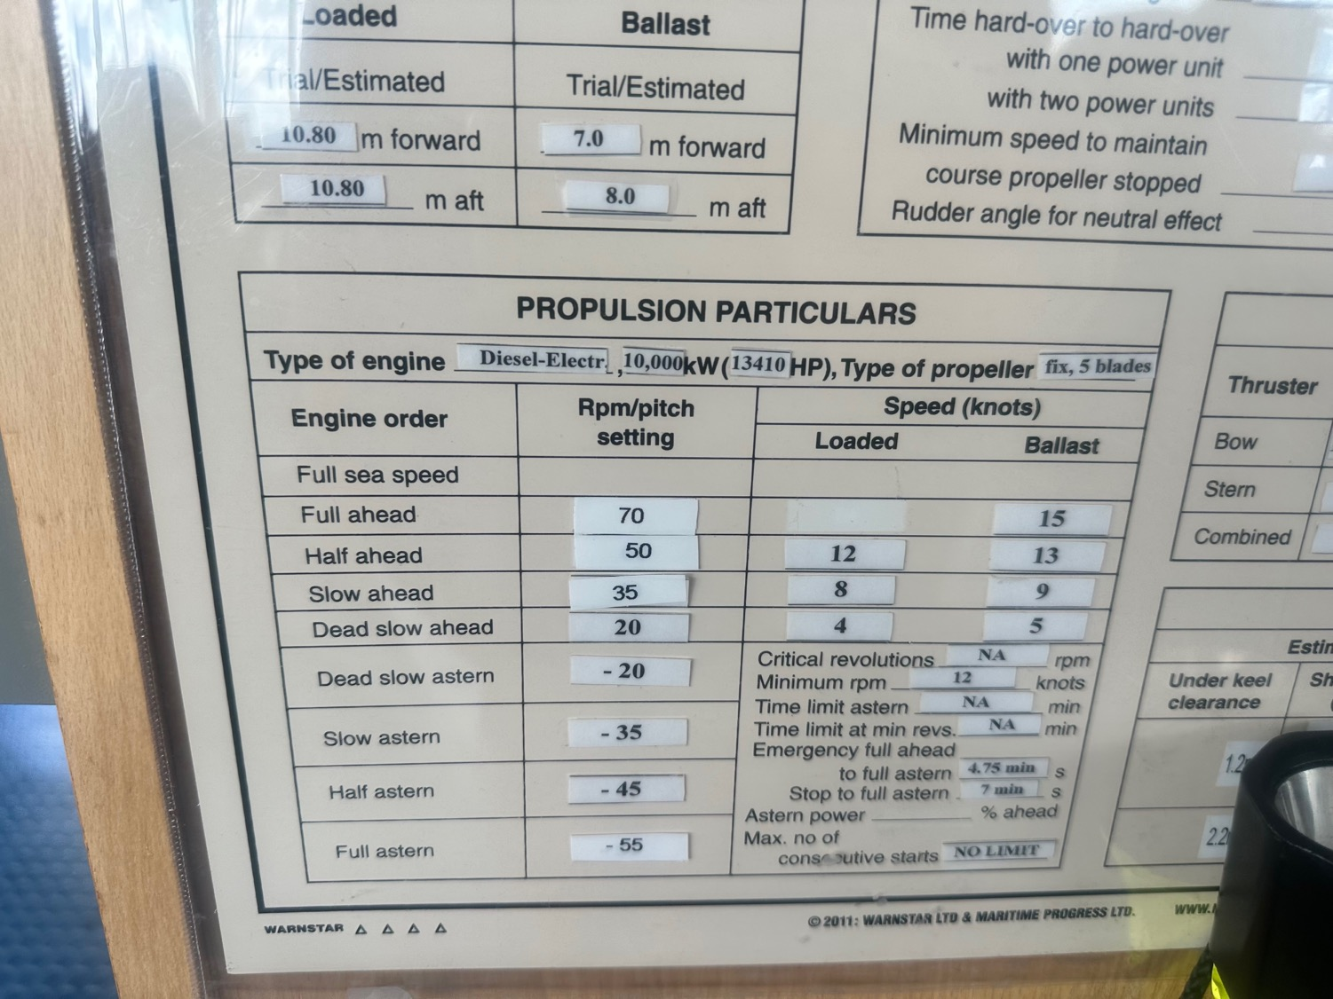
Mid 2023, Started Seeing Modified Pilot Cards
“Someone grab the label maker”

Slide 3
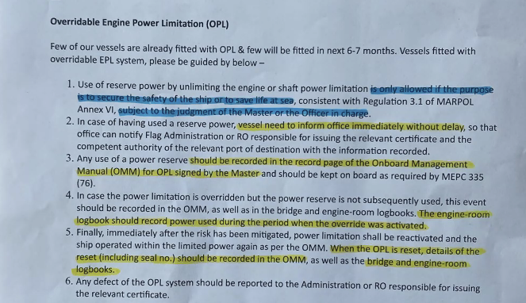

Slide 4
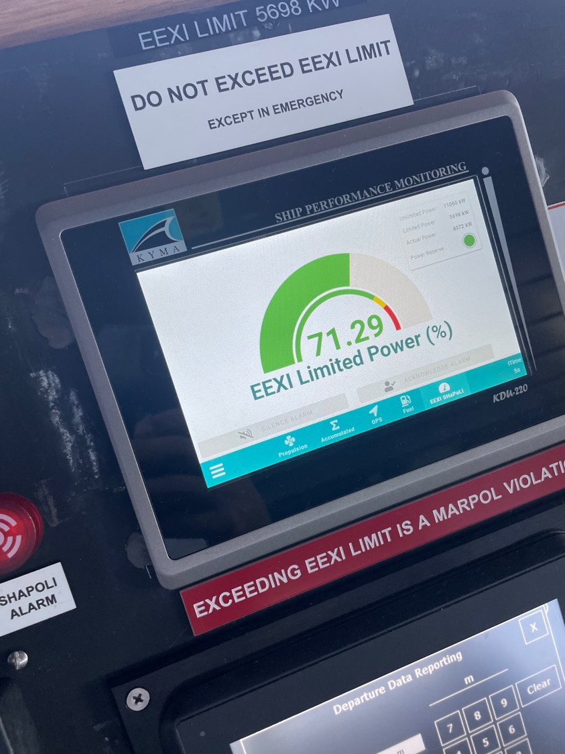
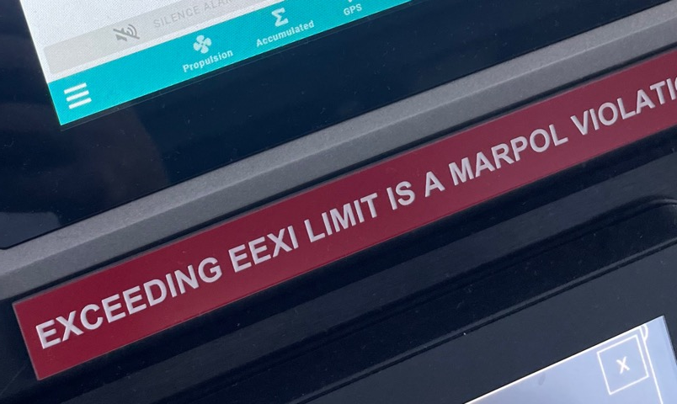

Slide 5
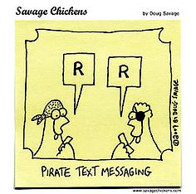
New acronyms
CII
EEXI
EPL
SHAPOLI

Slide 6
“Let’s have a meeting”

Slide 7
EEXI/EPL Jan Hagen Andersen BD/Regional Decarbonization Director
Presented at the Houston Pilots August 14th, 2023

Slide 8
New Orleans - Baton Rouge Pilots Shared a Near Miss – Bulk Carrier w/EPL
Panamax ship with new EEXI power reduction
Only 4700 hp remains after engine modification
Ship is uncontrollable in the Mississippi River current
Doesn’t have enough power to steer
Has one grounding and one near miss with bridge and other vessel
Notes:
Capt. Jason Ledet with NOBRA showed a video and PPU playback of a near miss due to EPL’s that shocked the audience.

Slide 9
Bulk Carrier w/EPL uncontrollable

Slide 10
“We Need a Common Sense Approach”

Slide 11
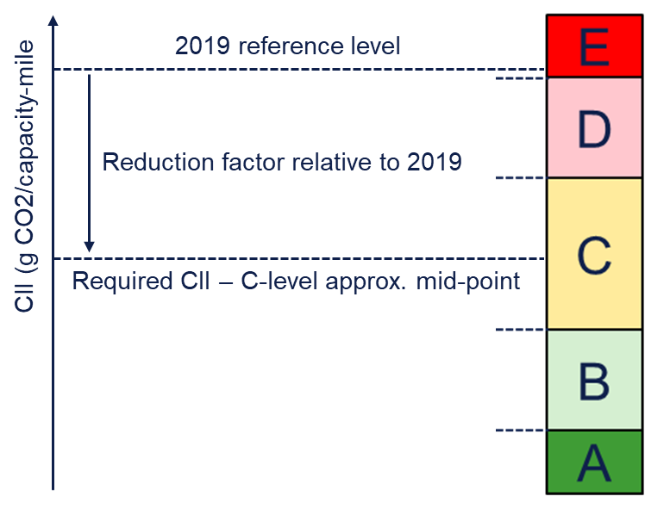
CII – In short (Carbon Intensity Indicator rating)
Year | Reduction from 2019 ref. (mid-point of C-rating)
2023 | 5 %
2024 | 7 %
2025 | 9 %
2026 | 11 %
2027-2030 | To be decided
Scope: Cargo, ro-pax and cruise ships above 5000 GT
Requirements:
Every year from 2023: Annually calculate and report Carbon Intensity Indicator and rating A to E. Each ship needs to achieve rating C or better
Enforcement:
If rating D for 3 consecutive years or rating E: develop and implement an approved corrective action plan as part of SEEMP to achieve the Required CII
Attained

Slide 12
Carbon Tax? Who, us?
Photo: Livebunkers

Slide 14
Our Position: CII-EEXI Should Be Seabuoy to Seabuoy
This is where the carbon reductions make sense

Slide 15
HPA EPL Data Collection (5 months of data)
Started EPL data collection in early September 2023 (9/11/23) when taking order for the Pilot.
Over 5 months of data collection, 45% of ships reported they were equipped with EPL’s.
Gradual increase of those ships equipped with EPL’s from 41% (September) to 48% (January)
Most ships have software based EPLs (78% of ships reporting they had an EPL).
Most older ships (built prior to 2014) have mechanical based EPL’s – 92% of mechanical systems are installed are on ships older than 2014
Most ships (75%) disable prior to taking a Pilot. Of those that were not disabled prior to Pilot, 68% were software based that could be disabled immediately.
Of ships that did not disable their mechanical EPL’s prior to taking a pilot (127), 60% were tankers, 19% were container vessels & 12% were bulkers.
Of ships that did not disable their mechanical EPL’s prior to taking a pilot (127), NOTES varied from can be overridden immediately (and varying amounts of time from 30 seconds to 15 minutes), only in an emergency, at Pilots request, and cannot be disabled.

Slide 16
Data Collection (5 Months)
Is vessel equipped with EPL?
YES: 45% (2951)
NO: 55% (3563)
If equipped, is the EPL software based or mechanical?
If equipped, will the EPL be disabled prior to taking a Pilot?
If equipped, how long does it take to disable the EPL if requested?
If equipped:, software or hardware based?
Software based: 78%(2271); 51% of software based EPL installed on ships newer than 2014
Mechanical: 22% (644); 8% of mechanical EPL installed on ships newer than 2014
Disabled prior to taking Pilot:
Yes: 75% (1174); software/hardware ratio (76%/24%)
No: 25% (398); software/hardware ratio (68%/32%)

Slide 18
MSIB 24-23 Use of Software or Mechanical Based Engine or Shaft Power Limiters
In accordance with Title 33, Code of Federal Regulation (CFR), Part 164.11(k), Pilots must be informed of the ships maneuvering characteristics and any abnormal circumstances on the vessel that may affect its safe navigation. Pilot Cards and the Onboard Management Manual (OMM) shall be up to date and reference for information including:
(1) procedures for accessing power reserves,
(2) time required for unlimiting the ships limiter or governor (i.e., accessing unlimited (design) power reserves),
(3) the ships maximum unlimited (design) and limited power.

Slide 19
The rundown…
Gathering the stakeholder team was successful in understanding the problem.
Local and nation regulation has been drafted in record time.
The “informercial” video is effective to communicate with non mariners.
We hope the IMO revises CII/EEXI to be seabuoy to seabuoy
The partnership with the APA and IMPA is invaluable

Slide 20
Thank You Houston Pilots: Adapting to Engine Power Limitations Resulting from CII/EEXI Regulation
Capt. Clint Winegar
Presiding Officer, Houston Pilots

